Slide 1
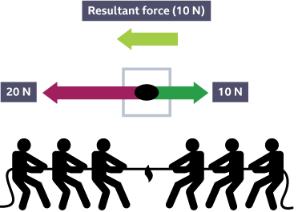
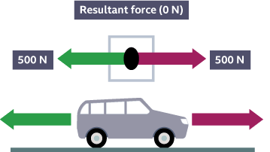
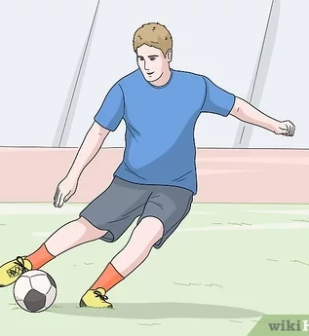
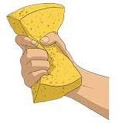
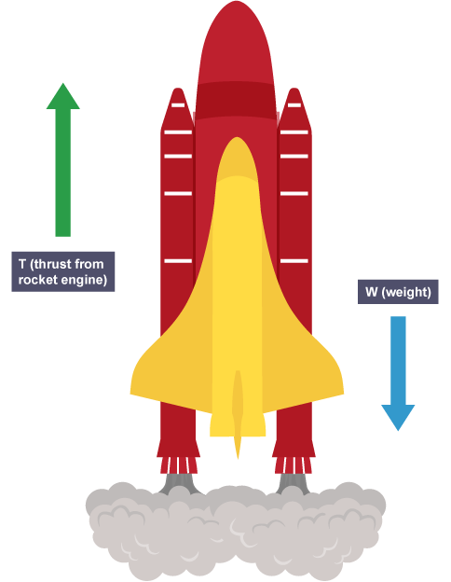

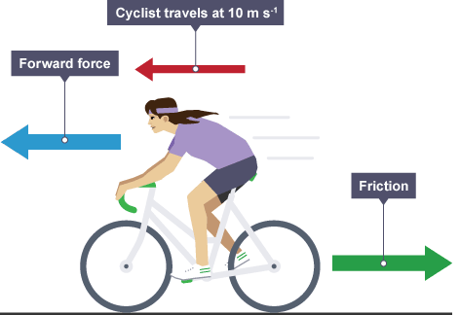
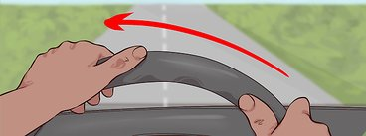
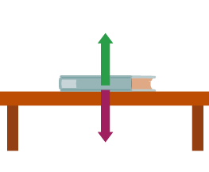
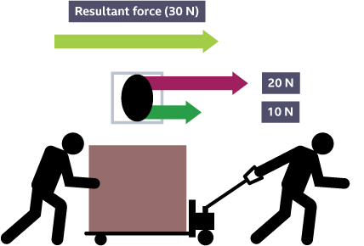


Knowledge Organiser
Year 7: Forces – Balanced Forces
What are balanced forces?
If the forces acting on an object are balanced we say there is no resultant force
This means that the forces are the same size but acting in opposite directions
If forces on an object are balanced, it is either stationary or travelling at a constant speed
A force diagram showing the result of two forces of different sizes acting in the opposite directions
What happens when a force acts on an object?
When a force acts on an object it can either make it change shape, direction or speed
The size of the force impacts the magnitude of the change
Usually more than one force is acting on an object, so we must determine the resultant force
What if the forces are unbalanced?
When forces are unbalanced it causes the speed of an object to change
This can be acceleration, where the object gains speed
Or deceleration, where the object loses speed
A force diagram showing the forces acting on a car travelling at a constant speed
Kicking a football makes it accelerate
Squeezing a sponge make it change shape
A force diagram showing the forces acting on a boat floating on a still ocean
A force diagram showing the a cyclist travelling at a constant speed due to the balanced forces acting on them
A force diagram showing a rocket that is accelerating upwards due to the unbalanced forces acting on it
Turning a steering wheel makes the wheels change direction
What is a resultant force?
When multiple forces act on an object at once, the resultant force is the overall force that acts on the object
Forces are vectors, this means the direction they act is important
How do we draw forces?
We can’t see forces but can see their effects
We draw forces as arrows on force diagrams
The arrow shows the direction the force is acting
The size of the arrow shows the size of the force
RAG Yourself!
Learning Outcomes; | RAG
State what is meant by a resultant forces
Calculate resultant forces on an object
Describe what is meant by balanced forces
Draw force diagrams using arrows
Explain why an object will start to accelerate
Explain how an object travels at a constant speed
A force diagram showing the forces acting on a book resting on a table
A force diagram showing the result of two forces of different sizes acting in the same direction

